Slide 1









IMDB DATA
ANALYSIS PROJECT

Slide 2

INTRODUCTION
In our IMDb data analysis project, we set sail into the expansive sea of data encapsulated within the IMDb dataset. This reservoir of information comprises diverse tables, offering intricate details about movies, directors, actors, genres, and ratings. Employing SQL as our compass, we navigate through this wealth of data to address a spectrum of advanced business questions. From discerning trends in genre preferences to evaluating the impact of directors and actors, our project aims to provide actionable insights for strategic decision-making.

Slide 3

DATASET
Director Mapping : This table Associates directors with movies they have directed, aiding exploration of directorial impact.
Genre : This table Classifies movies into different genres, enabling genre-based analysis of performance metrics.
Name : This table Contains information about individuals involved in movie production, such as actors, directors, and producers.
Ratings : This table Provides ratings and reviews for movies, allowing evaluation of critical and audience reception for each film.
Role Mapping : This table Maps actors/actresses to their roles in movies, facilitating analysis of individual performance.

Slide 4
PROJECT GOALS
Addressing Complex Business Questions: Utilize the IMDb dataset's breadth to dissect intricate inquiries such as the impact of genres, directors, and actors on movie success.
Uncovering Hidden Insights: Employ SQL to dig deep into the dataset, unveiling subtle yet crucial patterns and correlations that might otherwise remain unnoticed.
Storytelling with Data: Craft compelling narratives that seamlessly weave together the discovered insights, enabling stakeholders to grasp and act upon the implications effectively.

Slide 5
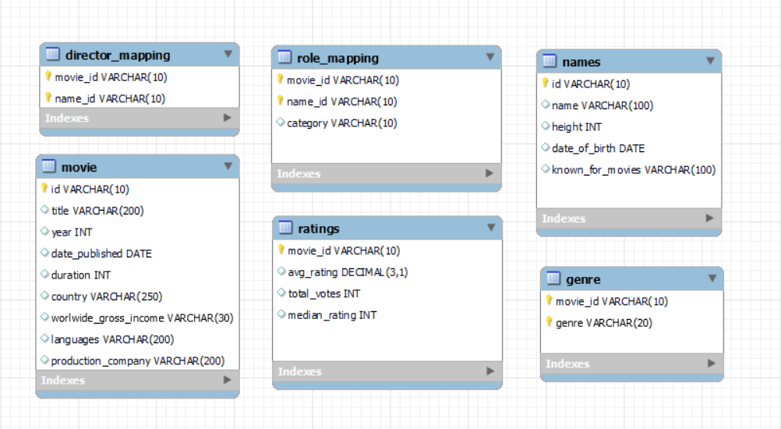
Entity Relationship Diagram

Slide 6
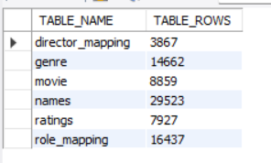
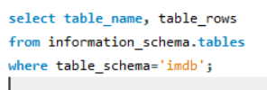
QUESTION 1
Find the total number of rows in each table of the schema?
QUERY
RESULT

Slide 7
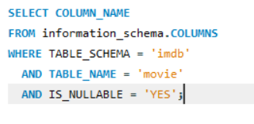
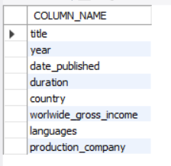
QUESTION 2
Which columns in the movie table have null values?
QUERY
RESULT

Slide 8
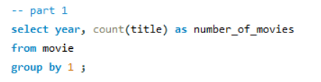
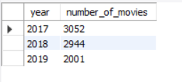
QUESTION 3
Find the total number of movies released each year?
QUERY
RESULT

Slide 9
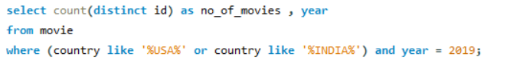
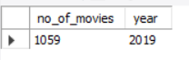
QUESTION 4
How many movies were produced in the USA or India in the year 2019?
QUERY
RESULT

Slide 10
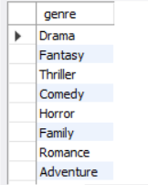
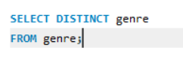
QUESTION 5
Find the unique list of the genres present in the data set?
QUERY
RESULT

Slide 11
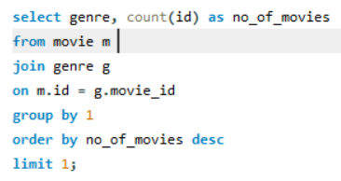

QUESTION 6
Which genre had the highest number of movies produced overall?
RESULT
QUERY

Slide 12
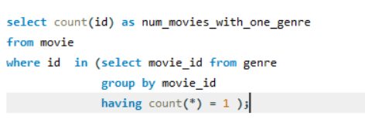
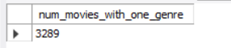
QUESTION 7
How many movies belong to only one genre?
RESULT
QUERY

Slide 13
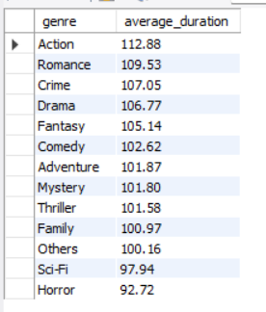
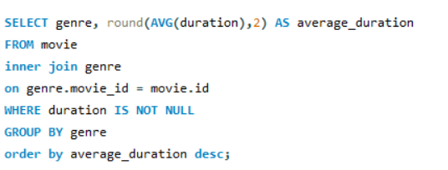
QUESTION 8
What is the average duration of movies in each genre?
QUERY
RESULT

Slide 14
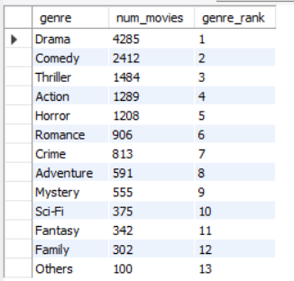
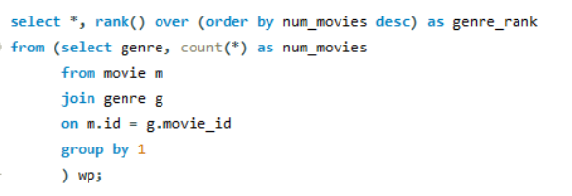
QUESTION 9
What is the rank of the ‘thriller’ genre of movies among all the genres in terms of number of movies produced?
QUERY
RESULT

Slide 15
QUESTION 10
Find the minimum and maximum values in each column of the ratings table except the movie_id column
QUERY
RESULT

Slide 16
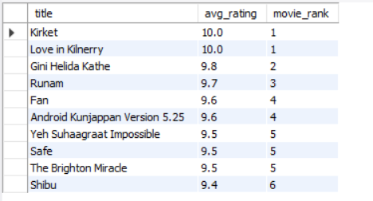
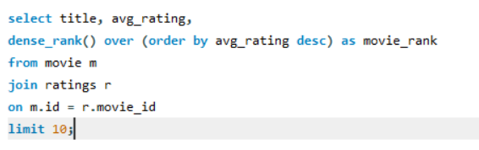
QUESTION 11
Which are the top 10 movies based on average rating?
QUERY
RESULT

Slide 17
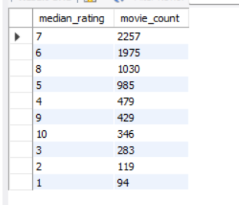
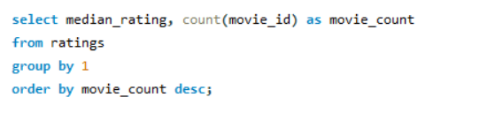
QUESTION 12
Summarise the ratings table based on the movie counts by median ratings.
QUERY
RESULT

Slide 18
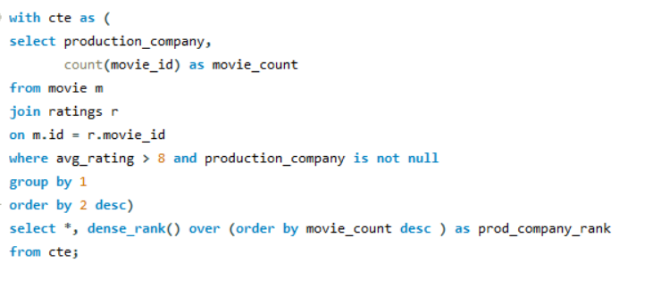
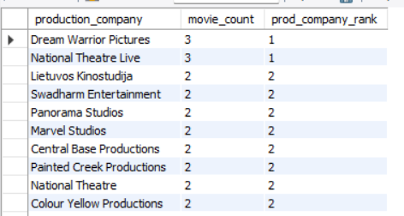
QUESTION 13
Which production house has produced the most number of hit movies (average rating > 8)?
QUERY
RESULT

Slide 19
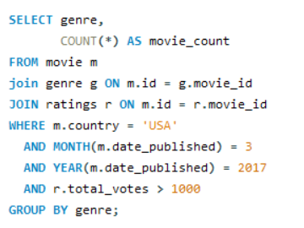
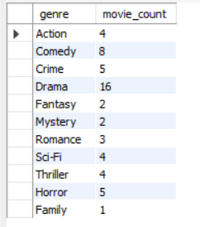
QUESTION 14
How many movies released in each genre during March 2017 in the USA had more than 1,000 votes?
QUERY
RESULT

Slide 20
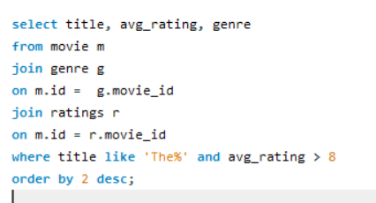
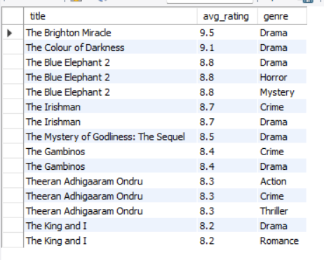
QUESTION 15
Find movies of each genre that start with the word ‘The’ and which have an average rating > 8?
QUERY
RESULT

Slide 21
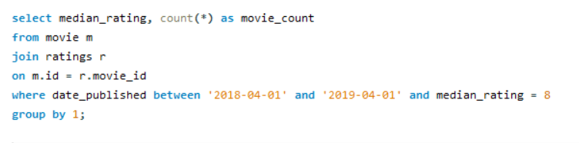
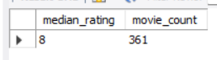
QUESTION 16
The movies released between 1 April 2018 and 1 April 2019, how many were given a median rating of 8?
QUERY
RESULT

Slide 22
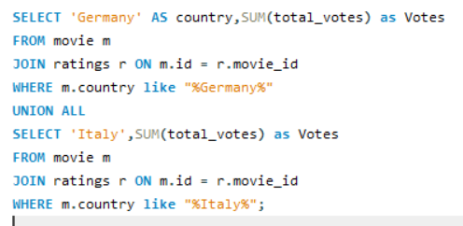
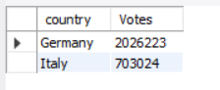

QUESTION 17
Do German movies get more votes than Italian movies?
RESULT
QUERY

Slide 23
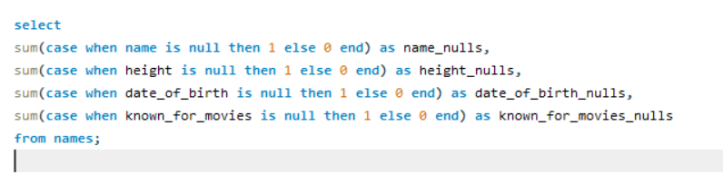

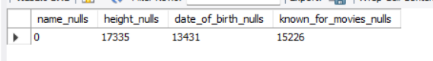
QUESTION 18
Which columns in the names table have null values?
QUERY
RESULT

Slide 24
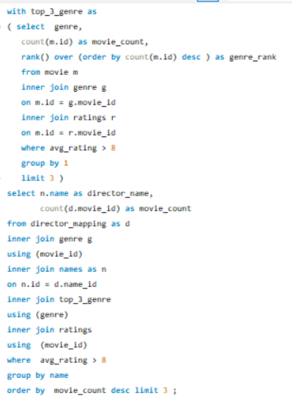
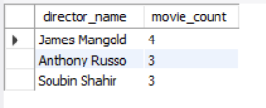
QUESTION 19
Who are the top three directors in the top three genres whose movies have an average rating > 8?
QUERY
RESULT

Slide 25
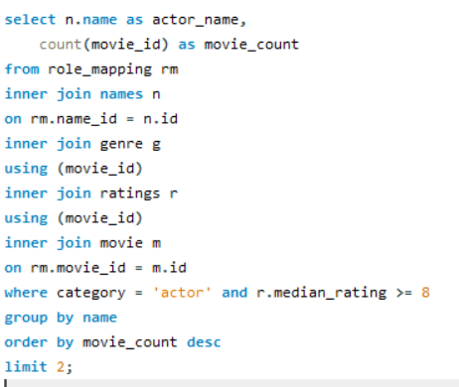
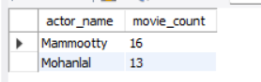
QUESTION 20
Who are the top two actors whose movies have a median rating >= 8?
QUERY
RESULT

Slide 26
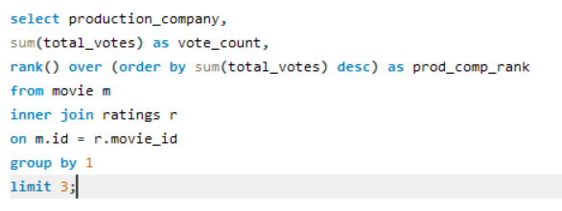

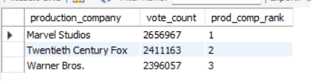
QUESTION 21
Which are the top three production houses based on the number of votes received by their movies?
RESULT
QUERY

Slide 27
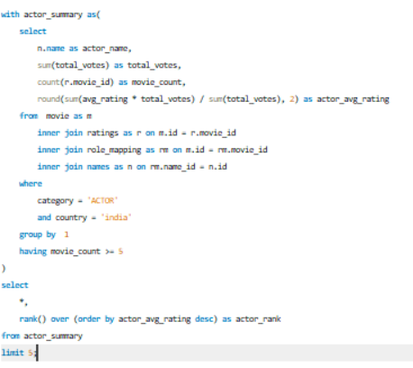
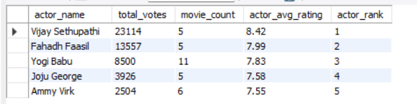
QUESTION 22
Rank actors with movies released in India based on their average ratings. Which actor is at the top of the list?
QUERY
RESULT

Slide 28
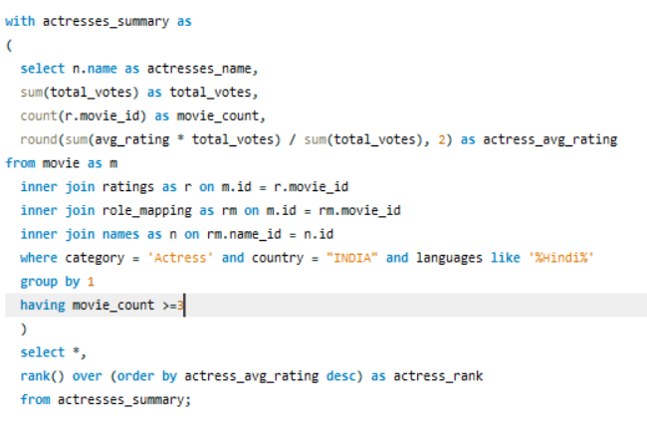
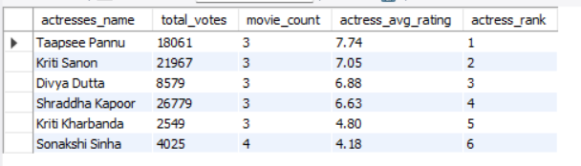
QUESTION 23
Find out the top five actresses in Hindi movies released in India based on their average ratings?
RESULT
QUERY

Slide 29
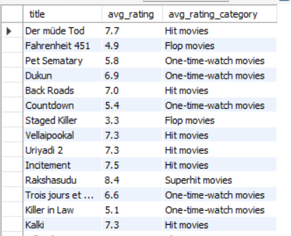
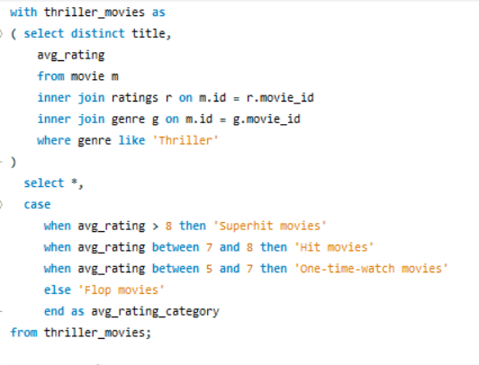

QUESTION 24
Select thriller movies as per avg rating and classify them in the following category:
QUERY
RESULT

Slide 30
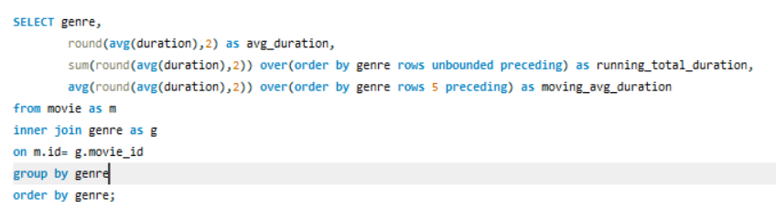
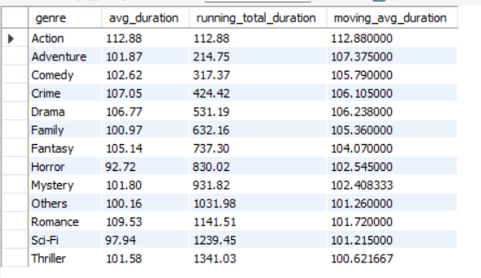
QUESTION 25
What is the genre-wise running total and moving average of the average movie duration?
RESULT
QUERY

Slide 31

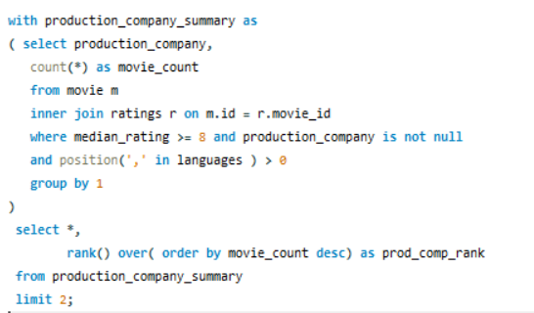
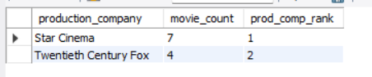
QUESTION 26
Which are the top two production houses that have produced the highest number of hits (median rating >= 8) among multilingual movies?
RESULT
QUERY

Slide 32


QUESTION 27
What is the genre-wise running total and moving average of the average movie duration?
RESULT
QUERY

Slide 33
THE END

Slide 34















RESOURCE PAGE

